Slide 1
UNIT 12: STRATEGIC GAME DEVELOPMENT TECHNIQUES AND CONCEPTS

Slide 2
UNIT DESCRIPTION
Activities in this unit of study are designed to focus on the creation of advanced animations and graphical user interfaces (GUI’s) that are adaptable to a variety of platforms and play levels.

Slide 3
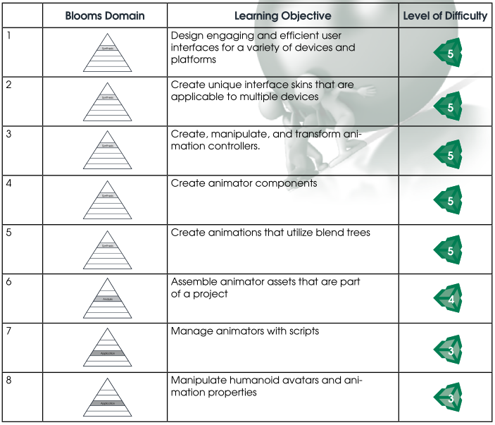
LEARNING OBJECTIVES
By the end of this unit, learners should be able to perform the following tasks:

Slide 4
1. Creating Intermediate Level Game Interfaces
a. Using Externally Created Skins in Unity
b. Custom GUI Styles in Unity

Slide 5
2. Creating Intermediate Level Animations in Unity
a. Intermediate Animations
b. Preparing Models for Animation
c. Humanoid Avatars
d. States and Blend Trees
e. Avatars

Slide 6
3. Project Creation
a. Project build

Slide 7
Creating Advanced User Interfaces in Unity
he tutorials listed below introduce intermediate level techniques for creating textures, skins, and environments for high quality game interfaces. They are offered to help learners enhance the design of their game. After viewing the tutorials, direct learners to return to their Capstone Project and examine ways to improve the user interfaces in their game.
1. Unity GUI Tutorial – Scale UI to the Right Size for Every Resolution
http://www.youtube.com/watch?v=hzvQnYkS9O4
2. Creating a GUI in Photoshop and Unity 3d Part 1
http://www.youtube.com/watch?v=H4Tpaq6D5cI
3. 3d Modeling Architecture Part 1: Planning your textures
http://www.youtube.com/watch?v=EwZyGoxqh2Y&list=PL3bRqax9US6LhaAPLagGp7j5RtuvEUB0H
4. Unity Game Design: Part 22-Gui Skin
http://www.youtube.com/watch?v=CfqM55K0rfU

Slide 8
Additional Skill Development in Unity
At this point, learners have created their game environment. But how creative, innovative, and effective are their GUI’s and animations? The next set of tutorials helps to expand learner skills with animation and GUI’s. Direct learners to complete the tutorials listed below. These tutorials will help them improve animation performance and player engagement:
1. Animation Advanced
http://unity3d.com/learn/tutorials/modules/beginner/animation/animator-component
2. Humanoid Avatars
http://unity3d.com/learn/tutorials/modules/beginner/animation/avatars
3. Blend Trees
http://unity3d.com/learn/tutorials/modules/beginner/animation/blend-trees

Slide 9
GUI and Animation Practice
Integrate the lessons learned in this unit towards the ongoing development of your Capstone Project. You should now possess the knowledge and skills necessary to enhance the animation and better engage the players within your game.

